Slide 1


Agile Development

Slide 2

Agile Roles
Product Owner
Point of contact in the Project.
Facilitates the project Success.
Scrum Master
Guides the team with agile principals.
Helps Product Owner.
Facilitates Scrums events.
Developtment Team
Cross-Functional
Collaborative
Consist of developers and testers.

Slide 3
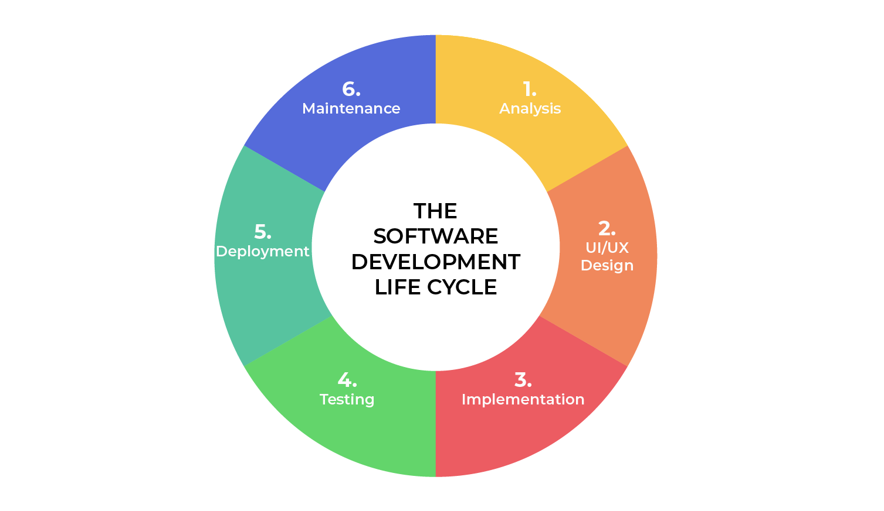
Software Development Lifecycle
Analysis
Communication and collaboration with Stakeholders.
Design
Detail draft of the design and functionality
Describe Project overview, technologies, budgeting and resources.
Implementation
beginning of the development.
Testing
Creating use cases and testing functionalities
Testing occurs at the same time of the development.
Deployment
Testing passed and ready to be released for use.
Maintenance
services after deployment to add more features and update the existing features.

Slide 4

Agile does not need all the requirements in the first place.
Consist of smaller tasks and sprints.
Changes will not effect the functionality in most part.
Planning has to be done in the beginning
Changes will effect the time, resources and budget.
Difficult to implement new features.

Slide 5

Refrences
Charles G. Cobb. (2015) The Project Manager’s Guide to Mastering Agile: Principles
and Practices for an Adaptive Approach. Wiley.
The Product Manager, & Clark, H. (2024, February 20). The Software Development Life Cycle (SDLC): 7 phases and 5 Models. The Product Manager. https://theproductmanager.com/topics/software-development-life-cycle/

